Slide 1
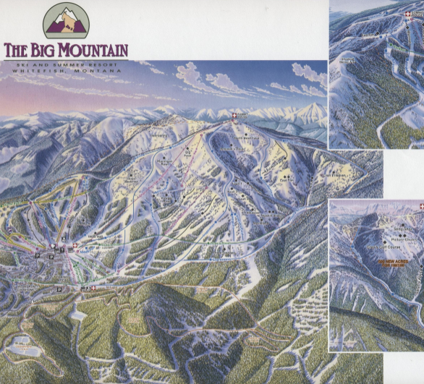
BIG MOUNTAIN RESORT DATA SCIENCE PROJECT
VISHAL RASTOGI
03/2022

Slide 2
PROBLEM STATEMENT
How can Data Science be leveraged at Big Mountain Resort to implement data-driven business\ strategy, and henceforth realize higher ticket price by showcasing better facilities & implement cost cutting measures, to generate additional profit higher than $1,540,000 in one year to recover additional operational costs and investments.
Scope:
One CSV File
Ticket price optimization
Possible cost-cutting
Criteria for Success:
Analyze Market Place Data
Recommend Solution for Ticket Pricing
Generate $1,540,000 additional profit
Constraints:
Only one csv file
No total visitor's info for other resorts
No comparative data for weekday & weekend visitors
Stakeholders:
Executive Management Team
Key data sources
Csv File
Metadata

Slide 3
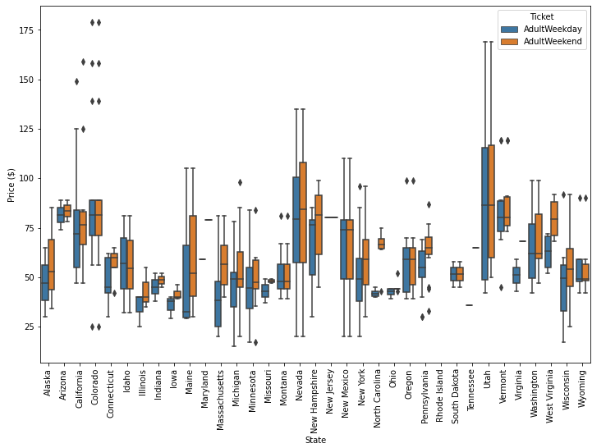
BIG MOUNTAIN RESORT KEY SELLING POINTS
total_chairs | 14
Runs | 105.0
TerrainParks | 4.0
LongestRun_mi | 3.3
SkiableTerrain_ac | 3000.0
Snow Making_ac | 600.0
daysOpenLastYear | 123.0
yearsOpen | 72.0
averageSnowfall | 333.0
AdultWeekday | 81.0
AdultWeekend | 81.0
projectedDaysOpen | 123.0
NightSkiing_ac | 600.0
Price Dynamics for States

Slide 4
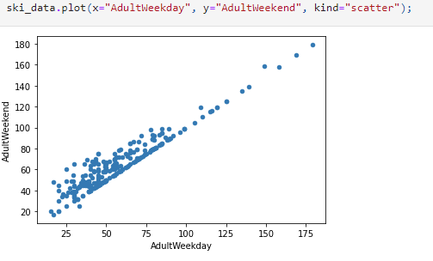
DATA WRANGLING
Data checked for missing values, type of data and data discrepancies
fast Eight feature dropped due to 50.30% missing values
Rows without ticket price info dropped
State population & area data merged with ski-data
Linear Relationship between Adult Weekday and Adult Weekend price
Adult Weekend selected as target feature due to less missing values
After wrangling 277 rows and 25 columns left

Slide 5
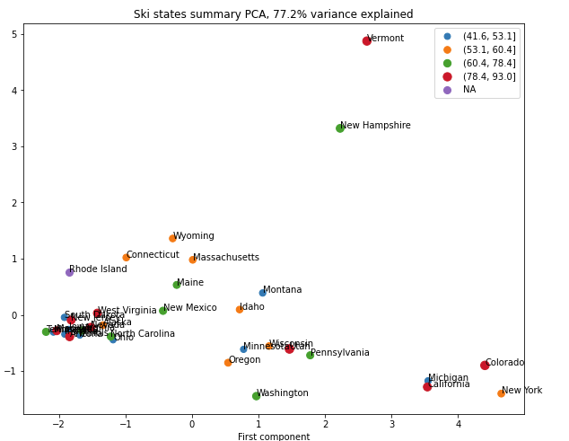

Exploratory Data Analysis
PCA Analysis:
Components 1 &2 alone explained 77% of the variation.
First 4 components explained 96% of the variation
State specific features not influencing ticket pricing

Slide 6
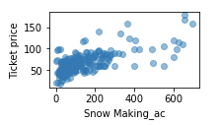
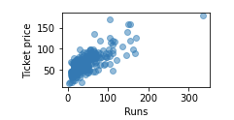
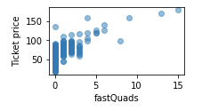
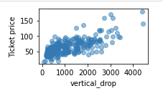
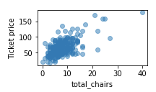
Exploratory Data Analysis
Scatter plot of features with ticket price
Very strong correlation with ticket price for features :
Run (0.76)
fastQuad(0.73)
Vertical drop (0.71)
Snowmaking(0.70)
Total chair (0.65)

Slide 7
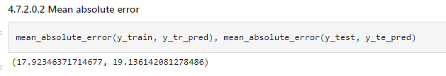


Preprocessing and Training Data
Extracted Big Mountain Resort Data
Train Test Split 70%/30%
R-squared, MSE, MAE Metrics Evaluated
Imputed Missing Values with Median on Train Data
Standard Scaler for scaling, 5-fold Cross-Validation
Dummy Regressor, Linear Regression Model
& Random Forest Regressor used for modeling
Performance evaluated on Test Data
Random Forest Regressor performed the best on Mean Absolute Error Metrics
Dummy Regressor
Linear Regression Model
Random Forest Regressor

Slide 8
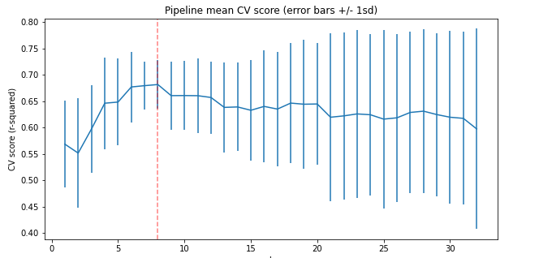
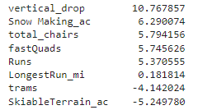
Preprocessing and Training Data
Linear Regression Model
Used GridSearchCV for parameters tuning
Best Model:
Standard Scaler=Standard Scaler
param_selectkbest__k=7 ( 8 Features)
Imputer Strategy=Median
Top Features

Slide 9
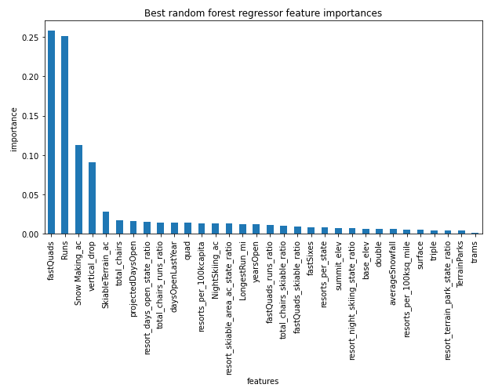

Preprocessing and Training Data
Random Forest Model
Used GridSearchCV for tuning
Best Model:
Standard Scaler= None
n_estimators': 69
Imputer Strategy=Median
Top Features

Slide 10
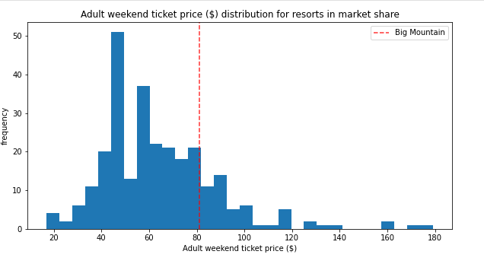
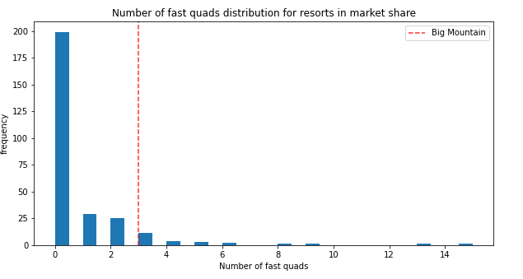
Modeling
Modeling Approach:
Big Mountain Resort removed from dataset
Refitted the model on dataset
CV Results revalidated with mean=10.39, std dev=1.47
Applied the model on our resort
Estimated price based on the model=$95.87
Plotted BM Resort for main features in market context (Red dotted Line)
Weekend Ticket Price
Fast Quads

Slide 11
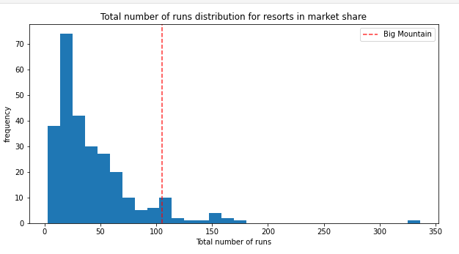
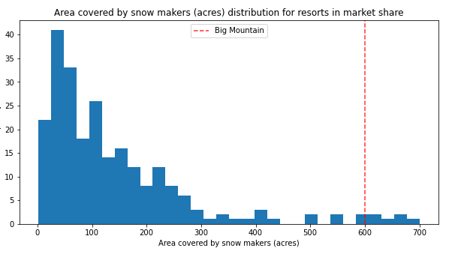
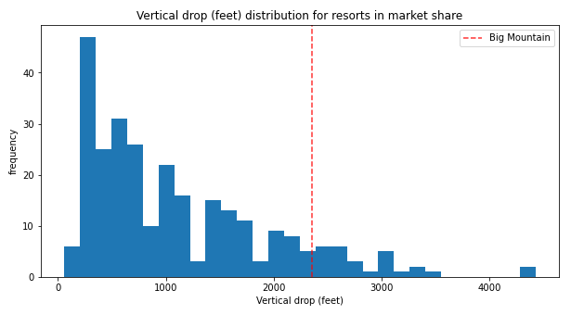
Modeling
Total Runs
Snow Making Area
Big Mountain Resort is on the upper end in market context , justifying premium pricing
Vertical Drop

Slide 12
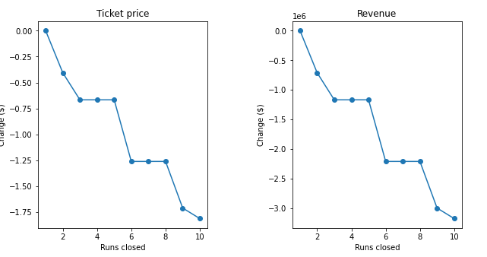
Business Scenario Analysis
Assumptions:
3,50,000 visitors per year buying 5 tickets each
Scenario 1
Closing up to 10 least used runs
Model Results
Ticket Price drop for first 3 run
No difference for 4th and 5th
Reduction in ticket price
Fast Quads

Slide 13
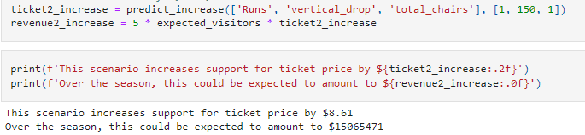
Business Scenario Analysis
Scenario 2
Adding a run, increasing vertical drop by 150 ft and adding a chair lift
Model Results:
Ticket Price increase by $8.61
Revenue increase by $15,065,471

Slide 14
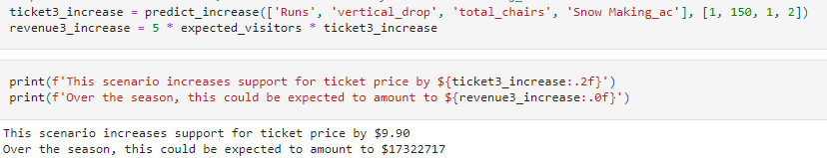
Business Scenario Analysis
Scenario 3
Adding a run, increasing vertical drop by 150 ft, adding a chair lift and 2 acres of snow
Model Results:
Ticket Price increase by $9.90
Revenue increase by $17,322,717

Slide 15

Business Scenario Analysis
Scenario 4
Increasing longest run by 0.2 miles and adding 4 acres of snow making capacity
Model Results:
Ticket Price increase by $0
Revenue increase by $0

Slide 16
Conclusion
,
Random Forest Regressor with 69 estimators provided the best model performance with lowest mean absolute error.
Most important features are fast Quad, Runs, Snow Making Area and Vertical Drop
The base model without any modifications to the features supports ticket price of $95.87 with MAE of $10.39, which builds a case for increase in ticket prices.
In perspective, $95.87 ticket price is enough to generate additional revenue of $26.02 Million which is much higher than additional operational cost of $15.4 million and easily covers the additional operational cost
Scenario 2 and Scenario 3 can be considered for future changes after evaluating capital and operational costs associated with the changes.

